Slide 1

Data Polish
Show and Tell 20/10/23

Slide 2
Agenda
Communication
Knowledge sharing
Github
Milestones and learnings
Team Dynamics
Design workshop and feature prioritization

Slide 3
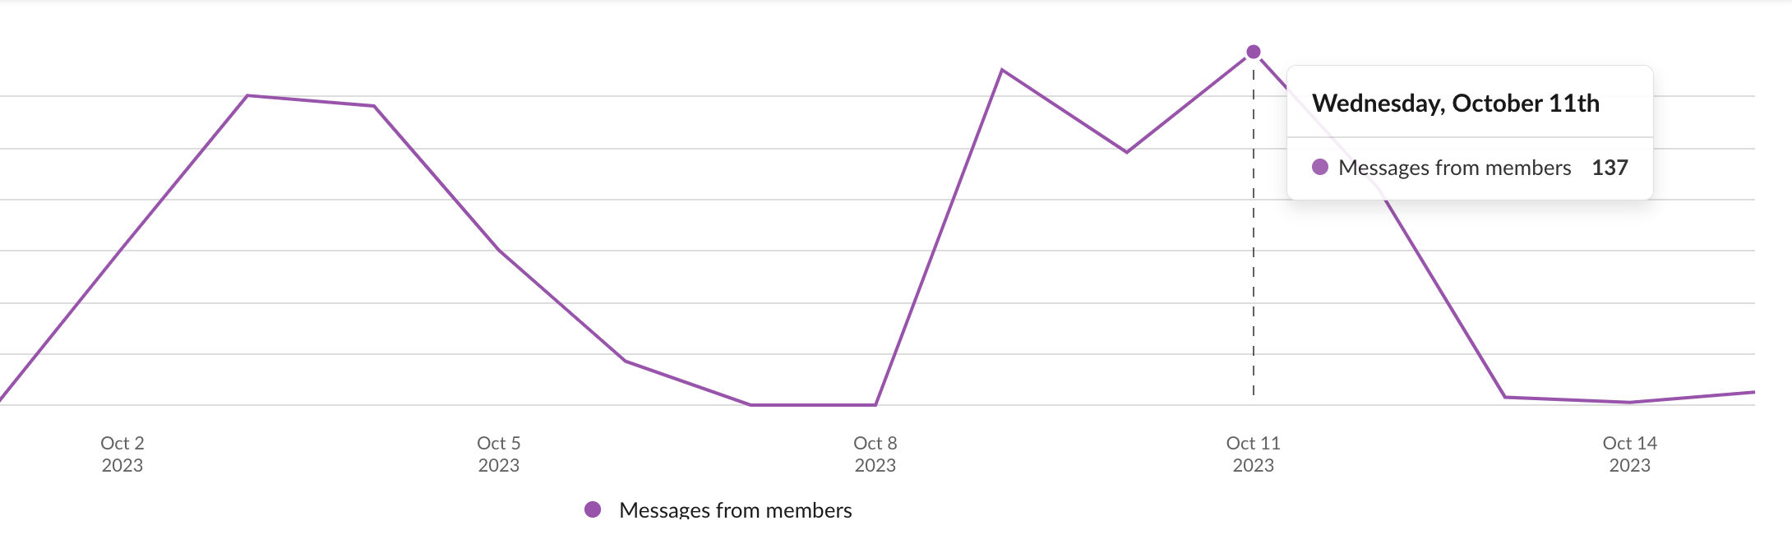
Communication
Team communicate through Slack instant messaging and daily stand ups on Teams.
Initial challenges were problems with focused conversations
Solution:
Primary communication tool switched from WhatsApp to Slack as it allows channels, threads and apps that connect to GitHub and Jira.

Slide 4
Knowledge sharing
To share knowledge, we have regular catch ups, share and communicate on slack and share on sprint meetings
ASD team have learned about data cleaning, data profiling, outliers and clustering
DS team have learned about API’s, coding in a software environment rather than notebooks and GitHub

Slide 5

GitHub management
Naveen has taken ownership of the GitHub.
Tracking with user stories on Jira.
Each commit must be reviewed by 2 team members before Merge.
Team is encouraged to add thorough reviews and feedback to each merge request.
Team pushes to development branch and then Naveen pushes to prod and main branches once a week on Wednesday evening.

Slide 6

Milestones and Learnings
Key Milestones yet to overcome:
Yet to get user feedback on stable MVP-1 release (Process to begin next week)
Column specific cleaning.
Interactive data profile dashboard.
Key Learnings:
Constant communication and collaboration is important.
Preparation before meetings or design activities is important to ensure the meeting or activity is productive.
Setting out goals for each sprint is important so that team has alignment and purpose for the week.
Importance of a white board (bonus)

Slide 7

Team problem solving and Dynamics
The team has regular daily stand ups that help solve day to day problems. 3 questions are asked of each person:
What did you do yesterday?
What are you doing today?
Any problems or blockers?
If yes, then we stay on the call and try to solve the problem as a team or split off on a separate call to solve the problem with relevant team members.
Team dynamics that may have to change for product to get to completion are
An increase in in person meetings
More efficient adhoc calls so that we can focus on development.

Slide 8
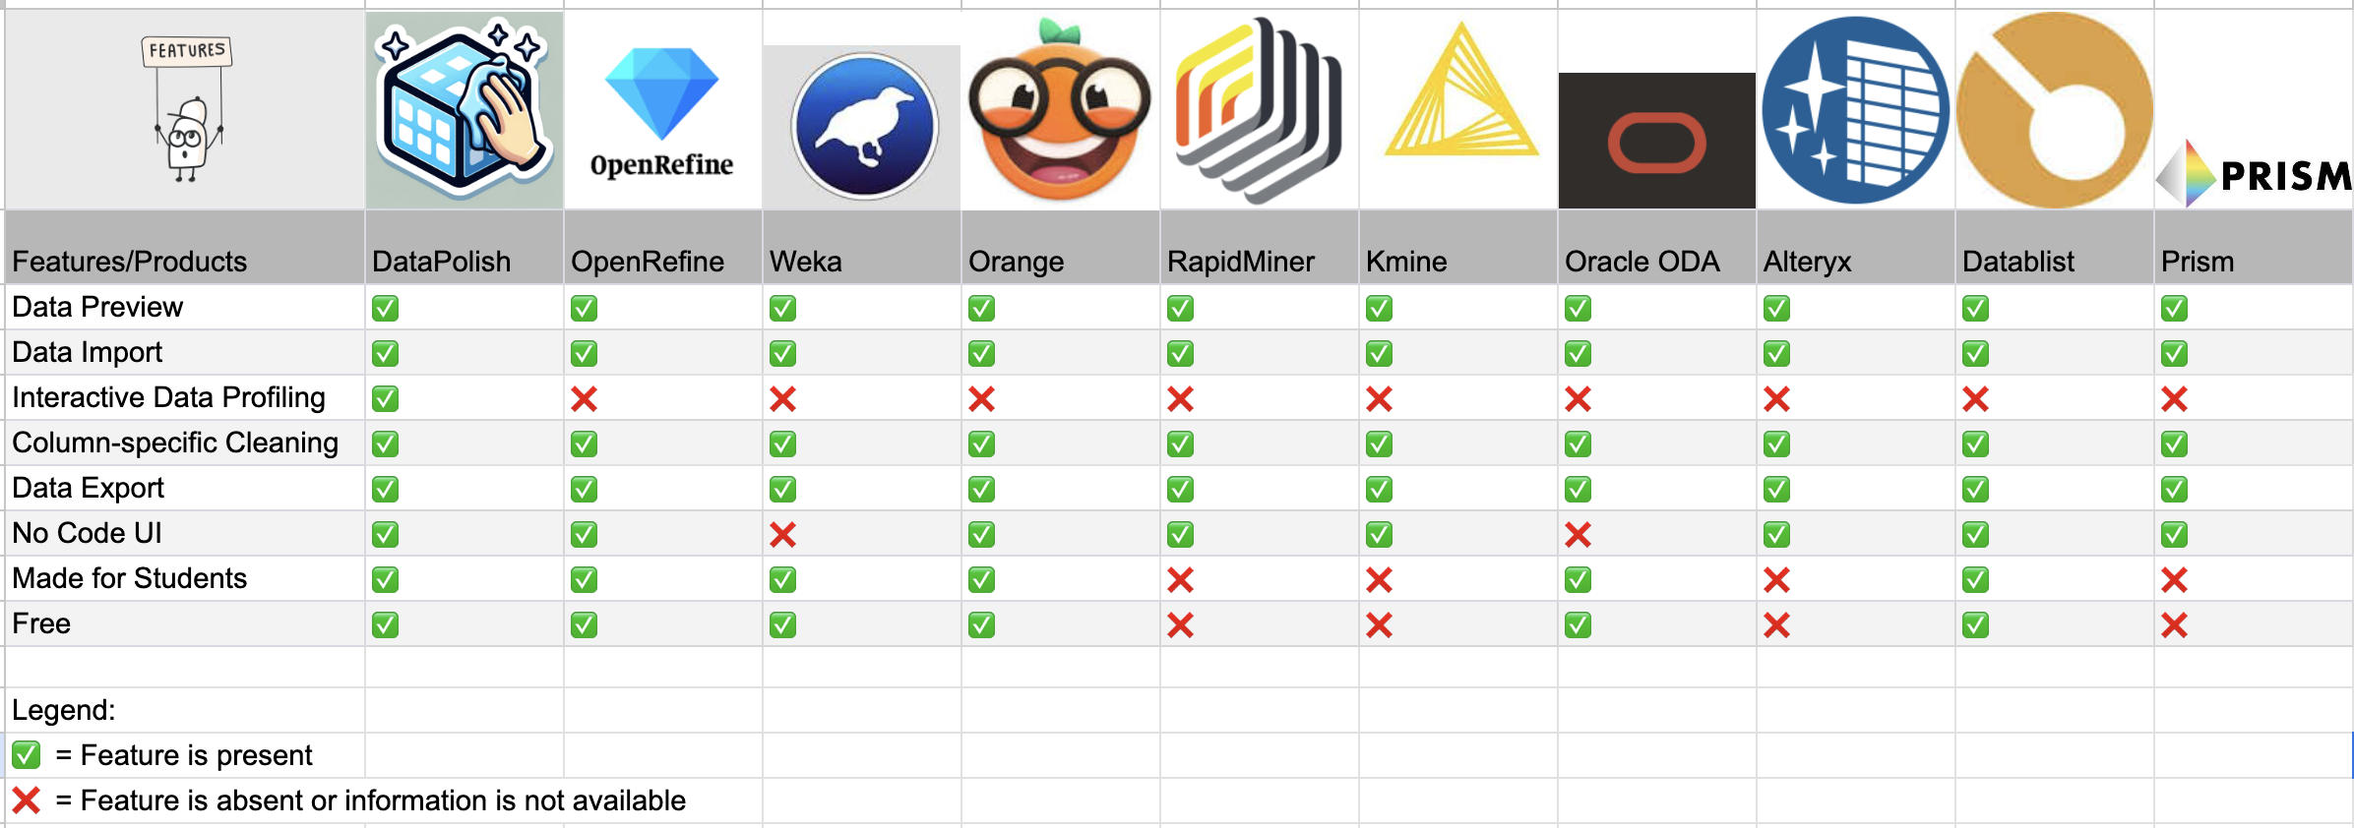
Design workshop
Compiled list of features gathered from research, competitor analysis and target user requests.
Planned the product roadmap until December (agile).

Slide 9
Key High-Level Feature Prioritization Key high-level features prioritized using the MoSCoW framework
Must Have
Data Importation
Data Cleaning
Data Export
Should Have
Data Profiling
Data Preview
Multiple Files
Could Have
LLM
ETL functionality
Data Analysis Feature
Machine Learning toolset

Slide 10
Prioritization of the Sub Features
KANO framework used
Why the KANO framework?
Good for when there is limited capacity and time.
Basic features set as priority
Excitement features set for later release.

